Slide 1
THE OU CINEMA Project Proposal
Dr.Ashraf Odeh

Slide 2
Group Members
1 | Bader Ayman Alhindi -- 202211117
2 | Abdelrahman Wael Ayyash -- 202211218
3 | Kareem Omar Yousef -- 202211378
4 | Abdallah Nedal Alrazem -- 202211119

Slide 3
Table of contents
01
02
03
04
About The Project
Topics Used
The Structs And Classes
05
Arrays
Static Members

Slide 4
Table of contents
06
07
08
09
Composition
Overriding &
Overloading
Friend Function
10
Template
Exception Handling

Slide 5
01
About The Project

Slide 6
THE OU CINEMA
The Movie Booking System is a software application designed to facilitate the process of reserving and managing movie tickets in a theater. The project aims to provide a user-friendly and efficient system for customers to book their preferred movie, time, and seats.

Slide 7
THE OU CINEMA
Key Features:
Movie Information : The system includes a class to store and manage movie details such as: title, genre, and cast. It provides functions to set and display this information.
Movie Time : Includes classes that handle the scheduling aspect of the system. They allow for adding and printing available movie timings and checking the validity of selected timings.
Seat Management : Includes a class that is responsible for managing individual seats in the theater. It provides functions to check seat availability, reserve seats, and display the seating arrangement.
Theater Management : Includes classes that serves as the main component of the system. It integrates the movie information, timings, dates, and seat management to facilitate ticket booking. It includes functions for booking and canceling tickets, displaying movie information and timings, checking seat availability, and printing tickets.

Slide 8
02
Topics Used

Slide 9
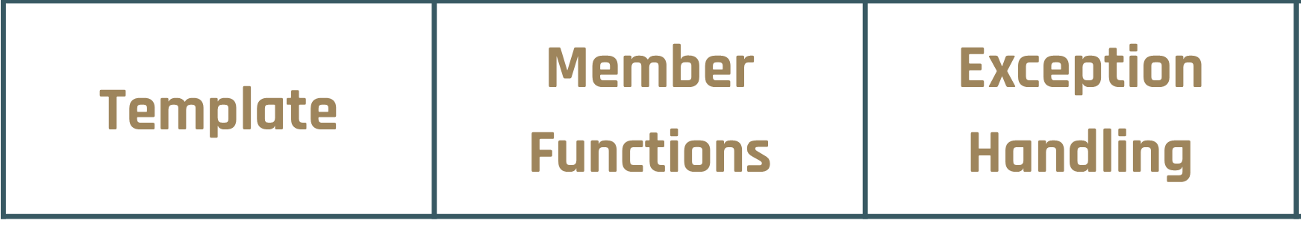
Topics Used
Array | Structs | Classes | Pointers
Constructors | Destructors | Static Members | Inheritance
Composition | Overriding | Overloading | Friend Function

Slide 10
03
The Structs And Classes

Slide 11
Structs
date1
movie
viewingtime
name: string
director: string
genre: string
age: int
cc: cast
day: int
month: int
year: int
min: int
hour: int
time1
cast
name1: string
name2: string
name3: string
min1: int
hour1: int

Slide 12
Classes
movietime
-min1: int
+printtime(): void
+setrt(int): void
+friend printrt(x: movietime)
moviedate
+printdate()void
(overloading)
info
movieinfo
+r: movie
+d: date1
+t[4]: viewingtime
+to: time1
+print(): void
-ticket : static int
+settime(viewingtime): void
+movieinfo(m: movie)
+choosetime(time1): void
+setdate(date1): void
+print(): void
+choosetime(viewingtime): void
+buyt(): void
+~movieinfo()

Slide 13
Classes
Theater
Seat
-numRows: int
-numSeatsPerRow: int
-seats[5][10]: seat
+Theater(numR: int, numSeat: int)
+isSeatAvailable1(row: int, seat: int): bool
+reserveSeat(row: int, seat: int): bool
+displaySeats()
-isAvailable : bool
+Seat()
+Seat(available: bool)
+isSeatAvailable(): bool

Slide 14
04
Arrays

Slide 15
Arrays
viewingtime t[4]: used to store the four different viewing times of the movie
Seat seats[5][10]: made to be able to manage around the theatre seats

Slide 16
05
Static Members

Slide 17
Static Members
static int ticket: equals 40 and is used to keep track of the number of available movie tickets.

Slide 18
06
Composition

Slide 19
Composition
The movieinfo class has composition relationships with the movietime and moviedate classes.
The Theater class has a composition relationship with the Seat class.

Slide 20
07
Overriding/Overloading

Slide 21
Overriding/Overloading
Overriding allows a derived class to provide a different implementation of a function defined in its base class, while overloading operators are functions with special names: the keyword "operator" followed by the name of the operator being defined. Like any other function, an overloaded operator has a return type and a parameter list.

Slide 22
Overriding/Overloading
Overriding:
The print() function is overridden in the derived class movieinfo from the base class info. The derived class defines its own implementation of the print() function, which overrides the implementation in the base class.
The overridden print() function in movieinfo class prints additional information about the movie, such as cast, release date, and viewing times.

Slide 23
Overriding/Overloading
Overloading:
friend ostream& operator<<(ostream& output, movieinfo& D)
This overload allows the movieinfo class to be printed using
the << operator.

Slide 24
08
Friend Function

Slide 25
Friend Function
void printrt(movietime x)
This friend function is defined outside the movietime class.
It takes a movietime object as a parameter.
Its purpose is to print the running time of the movie.
It is used in the main function to print the running time using the
printrt function.

Slide 26
09
Template

Slide 27
Template
the sum function is a template function that takes two parameters of different types (T1 and T2). It calculates the price of tickets and returns the result. The template allows the function to work with different data types, such as int, float depending on the type of ticket whether it’s a normal or a VIP one.

Slide 28
10
Exception Handling

Slide 29
Exception Handling
Exception Handling is used in the code to make sure the seat entered in the system exists in the theatre and is at the time not already reserved.

Slide 30
Thank You!
Startup Business Plan
ANY QUESTIONS?

